Slide 1

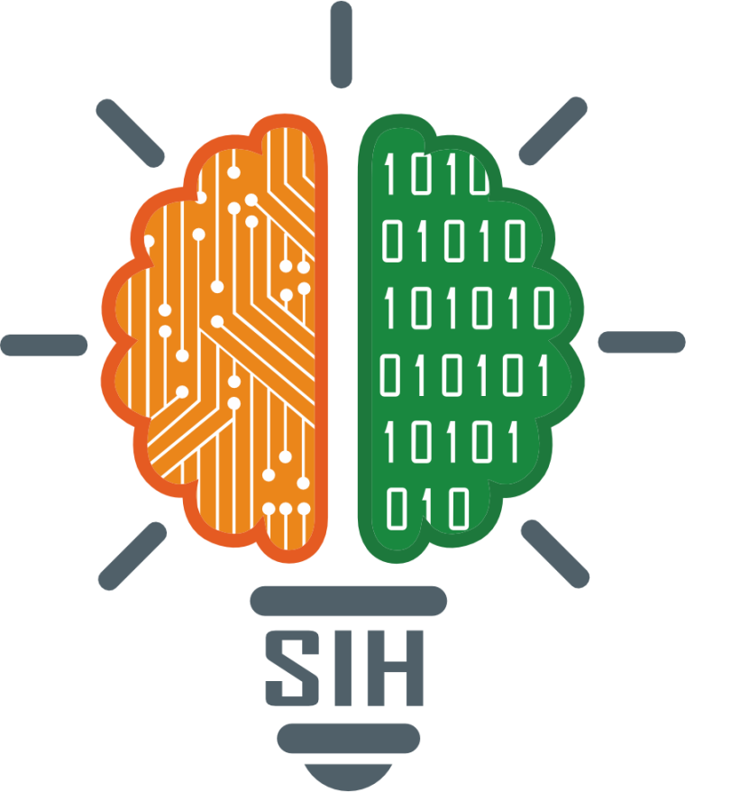
SMART INDIA HACKATHON 2025
TITLE PAGE
Problem Statement ID: 25157
Problem Statement Title: Identify the
mudras in Bharatiya Natya forms
Theme: Smart Education
PS Category: Software
Team ID: 65800
Team Name: Ignitia

Slide 2
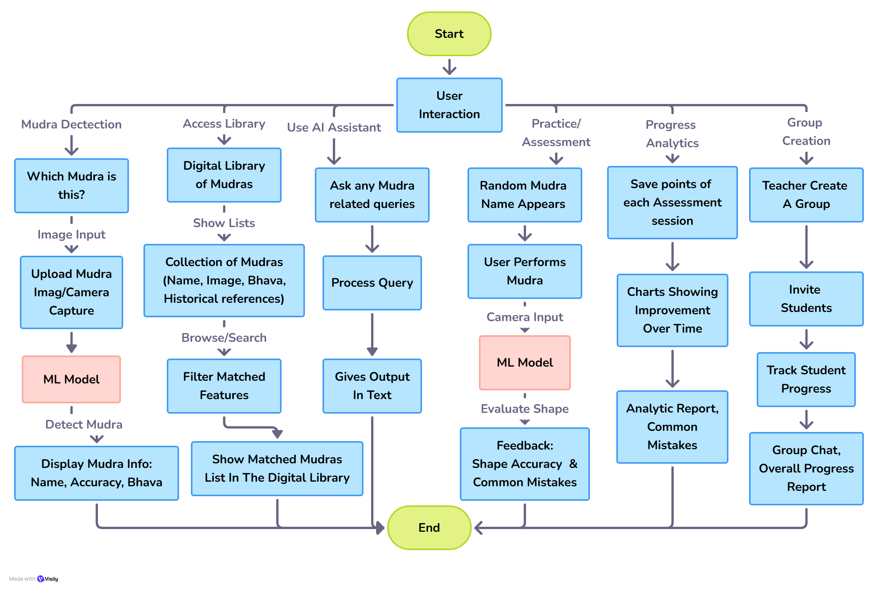
NrityaLens (Observing dance through AI)
Ignitia
Idea & User Workflow:
Problem Addressed:
No engaging digital platform for Bharatanatyam mudras
Audience struggles to understand mudras and loses emotional context.
Students often need repeated demonstrations for correct hand gesture
High time and effort cost for both teacher and student in mastering basics
Risk of cultural heritage fading without structured digital preservation
Idea / Solution: NrityaLens: AI-powered mudra recognition
Multi-mode interaction: Mudra Detection, Digital Mudra Library, AI Assistant
Practice/Assessment mode: Real-time feedback
(shape accuracy %, red/green finger markers)
Gamification: Badges, Progress Tracking, Group Learning
Purpose: Enhance learner engagement, Make practice interactive Searchable, Structured digital archive of Bharatanatyam mudras
Unique Value Proposition:
Beyond classification: Provides a complete digital library of all mudra details, Gamified learning keeps learners motivated.
Reduces repetitive effort for both teachers & students
Bridges artist–audience gap
Fusion of AI + Cultural Preservation
PROTOTYPE:
https://nrityalens.onrender.com

Slide 3






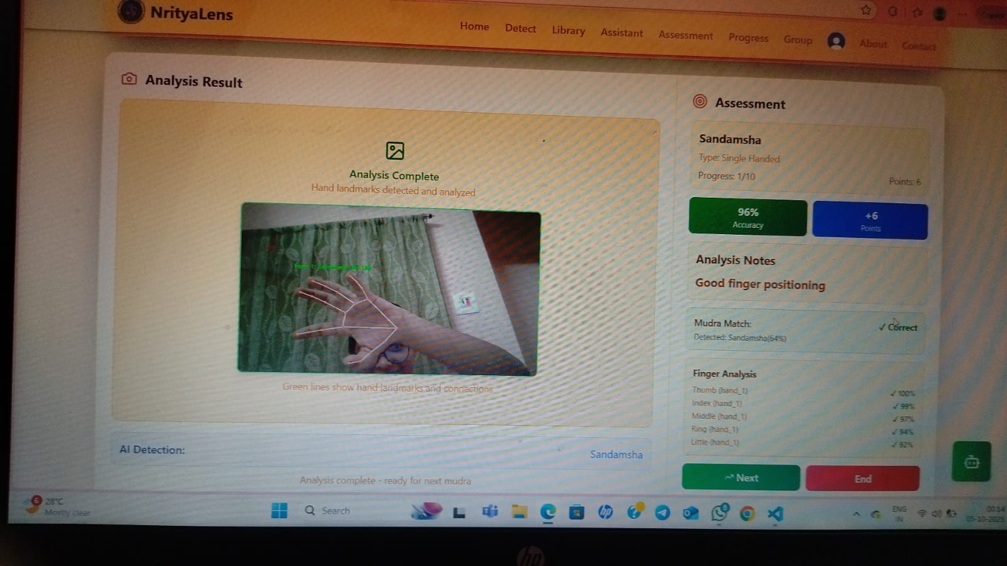
TECHNICAL APPROACH
Ignitia
Implementation Method & Technologies:
ML TASKS
API Calls (REST)
</> FRONTEND
Input Layer:
Upload Image/Video
Live Camera Capture
Preprocessing:
resize, RGB conversion, normalization
TensorFlow MobileNetV3 Model:
Input: Processed hand image
Output: Probabilities for all mudra classes
Top Prediction Selected:
Highest Probability Mudra
Name, Confidence
MediaPipe Hands Detection:
Landmark Extraction (21 Joints) Calculate finger positions & angles
OpenCV Annotation: Draw landmarks
Return annotated image
BACKEND
REACT
TAILWIND
CSS
NODEJS
PYTHON
Directs API info
AI ASSISTANT
DATABASE
QUERIES
GEMINI
DATABASE
MONGODB
INTEGRATE
EXTERNAL DATA
Modules Of Our Project:
AI Assistant: answers user questions using NLP and knowledge base
Output Using Our ML Model:
Mudra Detection: real-time hand gesture recognition with name and meaning
Digital Library: searchable collection of Bharatanatyam mudras with images, meanings, and videos
Assessment Mode: practice mudras with ML feedback and accuracy scoring
Progress Analytics: visual charts of performance, trends, and common mistakes
Virtual Classroom: teacher-student groups with shared progress and interactive features
https://youtu.be/gxu-PsTnWRw

Slide 4
FEASIBILITY AND VIABILITY
Ignitia
Feasibility of the Idea
Challenges and Risks
Tech: Gesture recognition, adaptable to Bharatanatyam
Scope: Finite, documented mudras
Cost: Works on webcams/smartphones
Scale: Extendable to other dances
Market Fit: High demand from students & teachers
Data: No large existing Bharatanatyam mudra dataset
Accuracy: Challenges in real-time recognition (light, occlusion, noise)
Adoption: Traditional artists may hesitate to trust AI
Ways to Tackle Risks
Business Potential
Dataset: Create custom dataset; apply augmentation
Modeling: Hybrid CV + deep learning (MediaPipe + CNN)
Testing: Pilot with artists to refine usability
Assistant: Position solution as AI-assistant (not replacement)
Collaboration: Partner with cultural institutes and art academies
Subscription: Features for learners & schools
Gamification: Duolingo-style mudra learning
Engagement: Tools for events & tourism boards

Slide 5
IMPACT AND BENEFITS
Ignitia
Potential impact on the target audience
Benefits of the solution
Students: Get guided AI feedback on basics, reducing repeated demonstrations and effort.
Audiences: Performances become interactive with real-time mudra meanings and emotions.
Cultural Institutions: Digitized, standardized mudra knowledge enables cross-border preservation and opens new educational/tourism markets
Teachers: AI co-teacher scales attention to 1 → 100+ students, reduce time spent manually correcting mudras.
Social: Preserves cultural heritage and engages youth through gamified learning
Economic: Enables EdTech, AR/VR apps, tourism ties, and new revenue streams.
Cultural: Blends AI with Nritya Shastra while documenting regional mudra variations.
Environmental: Digital training reduces manuals, travel, fuel use, and carbon footprint.
Supporting Facts
An article from Journal of Eye Movement Research Research shows experts perceive subtle Bharatanatyam emotions that general audiences often miss → Interactive tools can bridge this gap
A study on Hindustani music perception found that Emotional understanding in dance decreases without cultural and contextual knowledge.

Slide 6
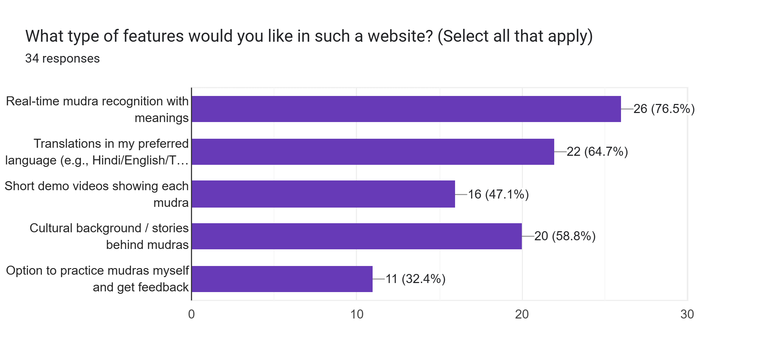

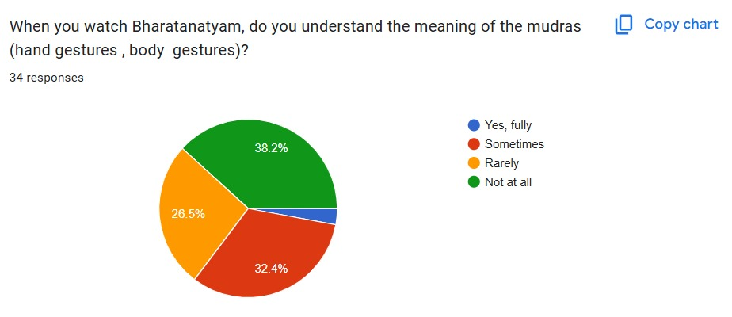
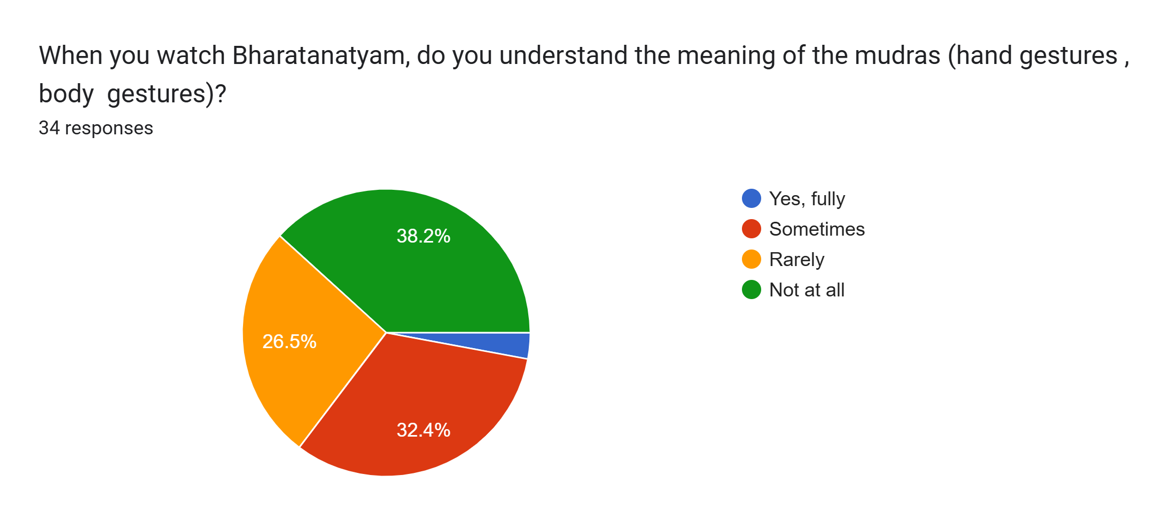
RESEARCH AND REFERENCES
Ignitia
Research Papers:
Identification of Asamyukta Hasta Mudra Viniyogas in Bharatanatyam using CNN
Classification of Bharathanatyam Mudras Using Enhanced Deep Learning Technique
Knowledge Sources:
Kathakali Hand Gesture Recognition With Minimal Data
The Historical Context of Mudras and Spirituality
Cross-cultural references of mudras in Bharatanatyam
himalayanschooloftraditionaldance​
Data Sources:
Asamyuta Hasta Mudras Photo Gallery
Bharatanatyam-Mudra-Dataset-1
Bharatanatyam-Mudra-Dataset-2
Survey:
REPO LINK:
Shreya9code/SIH_2025
https://nrityalens.onrender.com

